Slide 1
Conducting IACUC Facility Inspections
Group 3 – LIQUID HARMONY

Slide 2
MODULE CONTEXT
Audience: New and experienced IACUC Members performing facility inspections.
GOALS:
IACUC should be able to properly conduct a facility inspection.
IACUC should know why they are required to conduct a facility inspection.

Slide 3
OBJECTIVES
The IACUC member should be able to:
Know (LOC) when to conduct a facility inspection.
Know (LOC) where to conduct the inspections-which facilities to inspect.
Apply (LOC/HOC) requirements of inspection.
Know (LOC) who is responsible for inspections.
Assess (HOC) animal welfare issues.
Generate (HOC) an end product/report.

Slide 4
FORMATIVE ASSESSMENT
The following materials would be provided for the assessments, may the force be with you:
Animal Care Inspection Guide
Animal Care Policies
The Guide/Public Health Service Policy
OLAW Semi-Annual Checklist
The USDA Animal Welfare Act and AW Regulations (aka Blue Book)

Slide 5
FORMATIVE ASSESSMENT
Should be able to know when to conduct a facility inspection.
Active Group Discussion (10 minutes):
Regarding when to conduct a facility inspection, please discuss the differences between The Guide, PHS Policy, AWA Regs, and AC Inspection Guide and Policies.
Task: Based on the above discussion, please develop a calendar indicating inspection dates

Slide 6
FORMATIVE ASSESSMENT (10 minutes)

Slide 7
FORMATIVE ASSESSMENT
Should be able to know where to conduct the inspections/which facilities to inspect.
Does your IACUC need to inspect the following areas?
(5 minutes)

Slide 8
Does your IACUC need to inspect the following area?

Slide 9
Does your IACUC need to inspect the following area?

Slide 10
Does your IACUC need to inspect the following area?

Slide 11
Does your IACUC need to inspect the following area?

Slide 12
Does your IACUC need to inspect the following area?

Slide 13
Does your IACUC need to inspect the following area?

Slide 14
Does your IACUC need to inspect the following area?

Slide 15
FORMATIVE ASSESSMENT
Should be able to apply requirements of inspection.
Group Discussion/Clicker as available (15 minutes for all three):
1. From the tip of the nose to base of tail, a Beagle is 24 inches in length and the animal is in an 8 sq ft. holding cage. There is no provision for exercise opportunities. If this is not an approved exemption, is this in compliance with federal regulations?

Slide 16
Should be able to apply requirements of inspection.
FORMATIVE ASSESSMENT
Group Discussion/Clicker as available:
2. There are five, 400 gram rats in 10.5 x 19 inch cage, is this compliant with The Guide? If this is non-compliant, is this a significant or minor deficiency?
3. Based on today’s date October 18th and you are inspecting today, you have NHP diet with a mill date of April 18, 2016. Can you still utilize the diet today (10/18/2016) and be in compliance?

Slide 17
FORMATIVE ASSESSMENT
Should be able to know who is responsible for inspections.
Which of the following could be included on a facility inspection? Yes or No cards for each. (5 minutes)
_______AV
_______IO
_______Any IACUC member who wishes to participate
_______Animal Facility Manager
_______At least two members of the IACUC for covered species
_______Compliance Officer
_______IACUC Administrator
_______An ad hoc consultant invited by the IACUC to assist

Slide 18
FORMATIVE ASSESSMENT
Discussion (Think-Pair-Share)
Think 30 second
Pair 2 minutes
Share 30 seconds
Does the PHS require a minimum number of IACUC members to participate in an inspection?

Slide 19
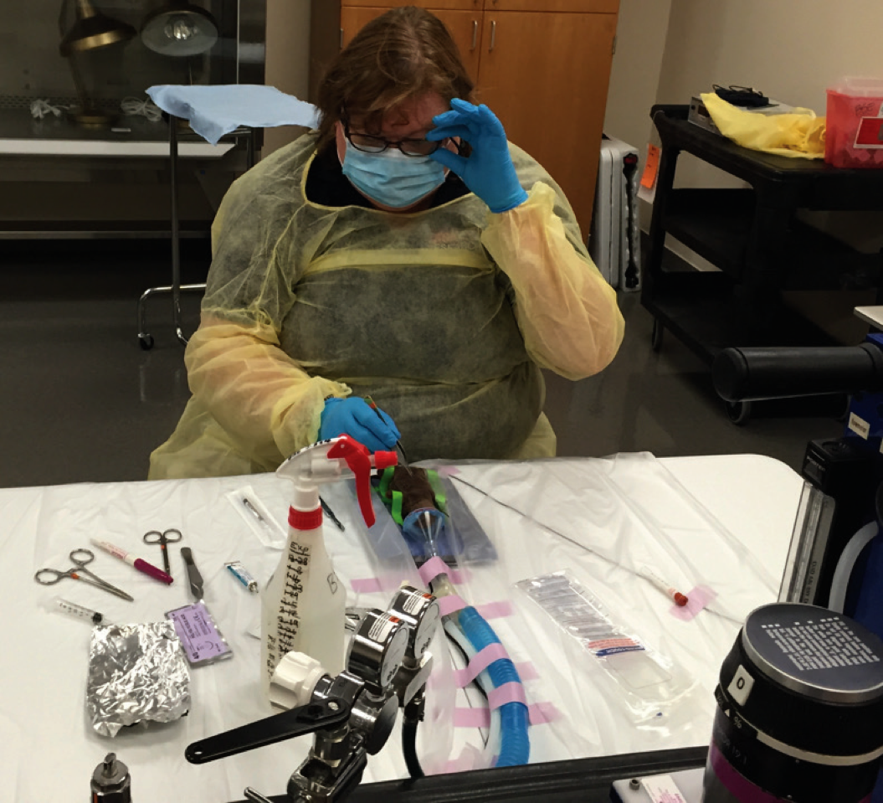
FORMATIVE ASSESSMENT
Should be able to assess animal welfare issues.
Pair up at your table with an experienced member and one new to the IACUC process to discuss the following scenario.
You walk into the lab and you see the below. A person performing survival surgery on a hamster. Identify potential concerns, including animal welfare issues (5 minutes).

Slide 20
FORMATIVE ASSESSMENT
Should be able to generate an end product/report.
Based on your findings from the scenario, please complete the facility inspection report. (5 minutes)

Slide 21
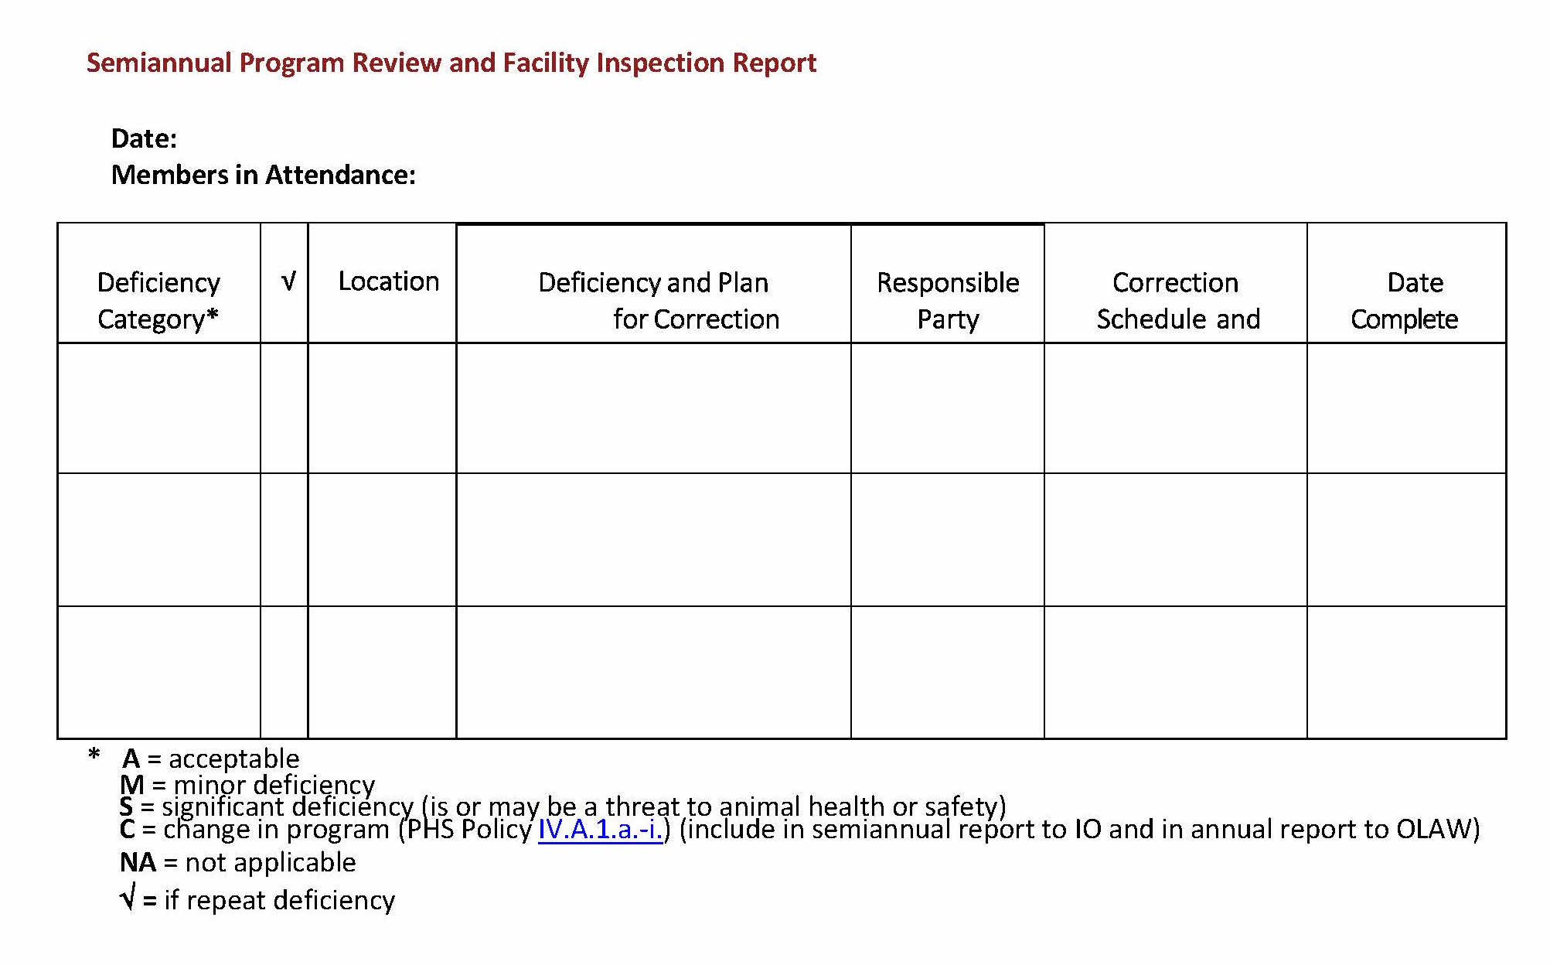
FORMATIVE ASSESSMENT

Slide 22
WHAT YOU SHOULD NOW KNOW:
When to conduct a facility inspection.
Where to conduct the inspections-which facilities to inspect.
Requirements of inspection.
Who is responsible for inspections.
Identify animal welfare issues.
Generate an end product/report.

Slide 23
SUMMATIVE ASSESSMENT
A lab utilizing mice in a vivarium with trio breeding with two different litters the inspectors notice litters with various dates of birth in the standard shoe box cage. Is this a problem according to federal regulations?
Compliant, no further action required
Non-compliant, fill out the facility inspection checklist
Unsure. Review institutional policy for a performance standard
Call the wonderful personnel at USDA to report a non-compliance

Slide 24
SUMMATIVE ASSESSMENT
When conducting an assessment what are the three categories of assessment? Circle all that apply:
Minor deficiency
Significant deficiency
Acceptable
Critical
Teachable moment

Slide 25
SUMMATIVE ASSESSMENT
According to federal regulations what are the minimal requirements for facility inspections needing to be conducted: Circle all that apply:
Yearly
Quarterly
Once every six months
Only after receiving a direct citation

Slide 26
SUMMATIVE ASSESSMENT
Which of the following is the IACUC responsible for inspecting as part of the facility inspection? Circle all that apply:
Food storage
Surgical areas
Locker rooms
Imaging areas
Labs performing euthanasia
Natural areas conducting observational wildlife studies with no pain or no negative affect on the animal studied

Slide 27
SUMMATIVE ASSESSMENT
Group discussion (15 minutes): Which of the following examples are significant deficiencies and why?
A dog in a cardiac study recovering from anesthesia which has been left unattended
Live animals found in the carcass freezer
Peeling paint in a NHP enclosure
Cage cards with inadequate information
Escaped baboon with serious injuries contained within the facility enclosure
A vial of Ampicillin which has expired

Slide 28
SUMMATIVE ASSESSMENT
True or false which of the following are required on the team for conducting facility inspections?
_______AV
_______IO
________Any IACUC member who wishes to participate
________Animal Facility Manager
________At least two members of the IACUC for covered species
________Compliance Officer
________IACUC Administrator
________An ad hoc consultant invited by the IACUC to assist

Slide 29
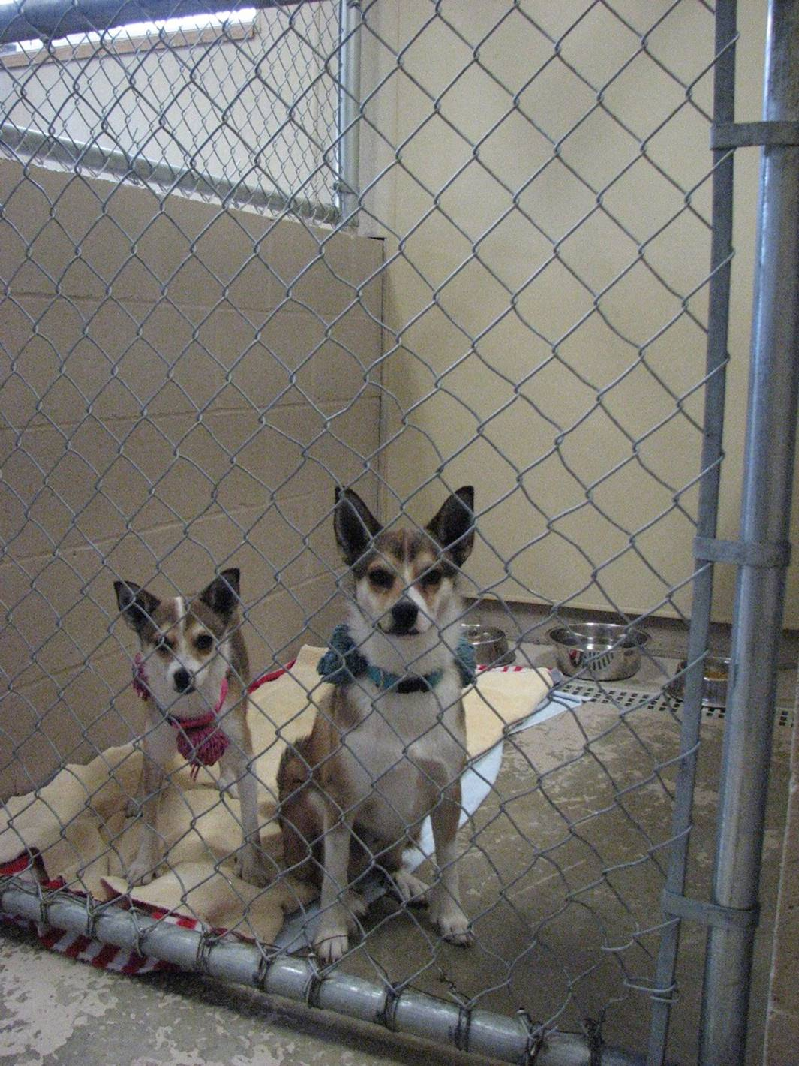
SUMMATIVE ASSESSMENT
During your inspection you see this enclosure.
Are there non-compliant issues and if so, why ( 5 minutes)?

Slide 30
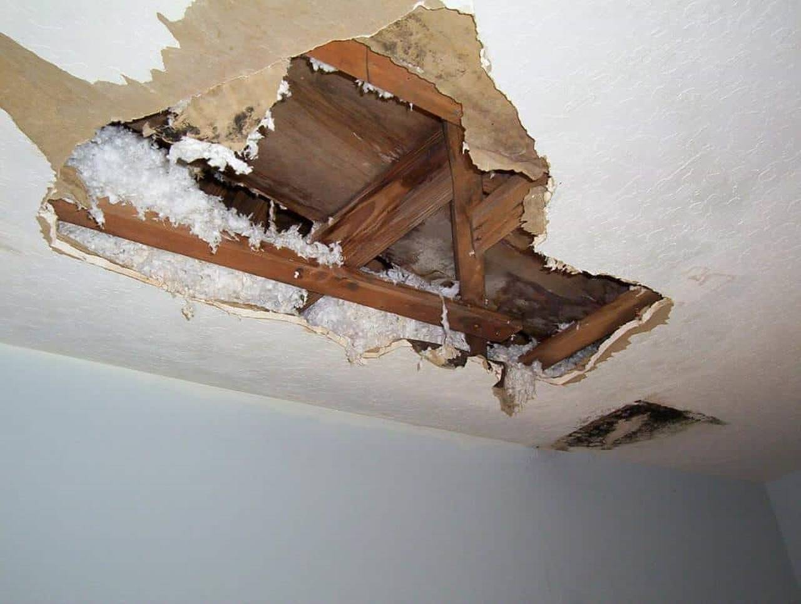
SUMMATIVE ASSESSMENT
During hurricane Michael the only surgical area suffered the above noted damage.
Are there non-compliant issues and if so, why?

Slide 31
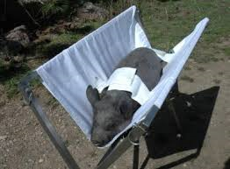
SUMMATIVE ASSESSMENT
The animal has been in the sling for a limited amount of time (no more than 15 minutes) for a vascular study.
Are there non-compliant issues and if so, why?

Slide 32
This awesome module has been brought to you by LIQUID HARMONY:
DAVE CANNON
JIM ELLIOTT
The EBS
JACKIE NEWELL-HUNT
MILDRED RANDOLPH
AXEL WOLFF

Slide 33
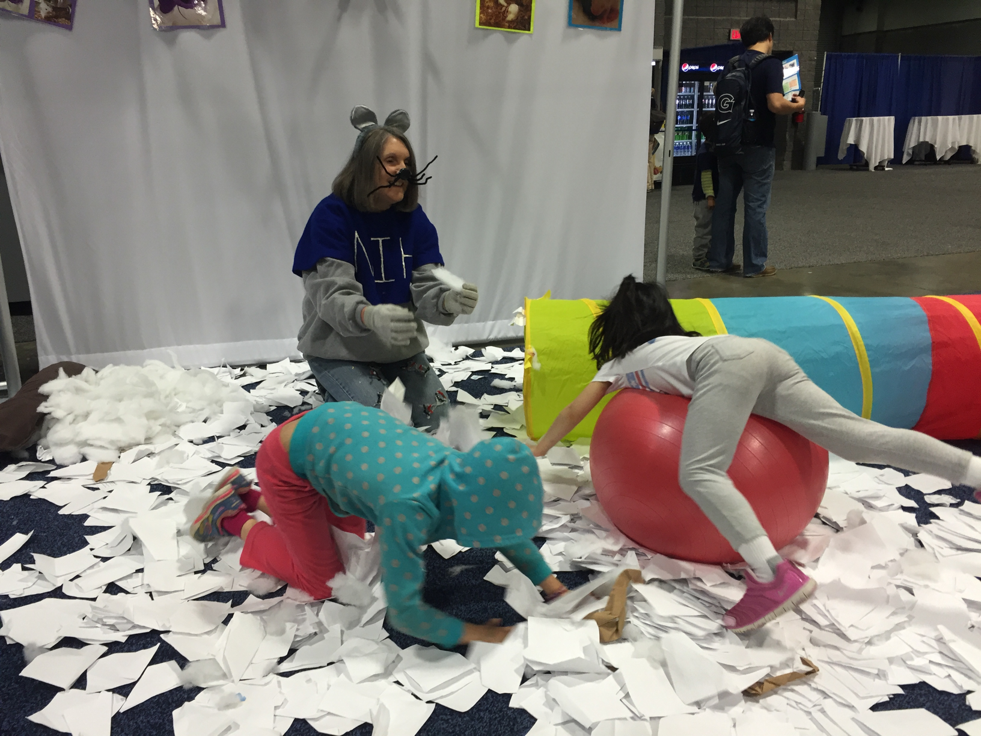
THANK YOU
To all the facilitators and all the people who tolerated Jim
Special thank you to our facilitator Dr. Brown

